Slide 1
CSS Flexbox
Layout
Utrecht, 13 November 2019
Maria Andreyeva

Slide 2
What Flexbox is & why we need it
For a long time, the only reliable cross browser-compatible tools available for creating CSS layouts were things like floats and positioning. These are fine and they work, but in some ways they are also rather limiting and frustrating.
The following simple layout requirements are difficult or impossible to achieve without Flexbox:
Vertically centering a block of content inside its parent.
Making all the children of a container take up an equal amount of the available width/height, regardless of how much width/height is available.
Making all columns in a multiple column layout adopt the same height even if they contain a different amount of content.
Sticky Footer ( footer that "sticks" to the bottom of the browser window if content on the page is short. But if there is enough content on the page to push the footer lower, it still does that. )
Flexbox is the short name for the Flexible Box Layout Module, designed to make it easy for us to lay things out in one dimension — either as a row or as a column.

Slide 3
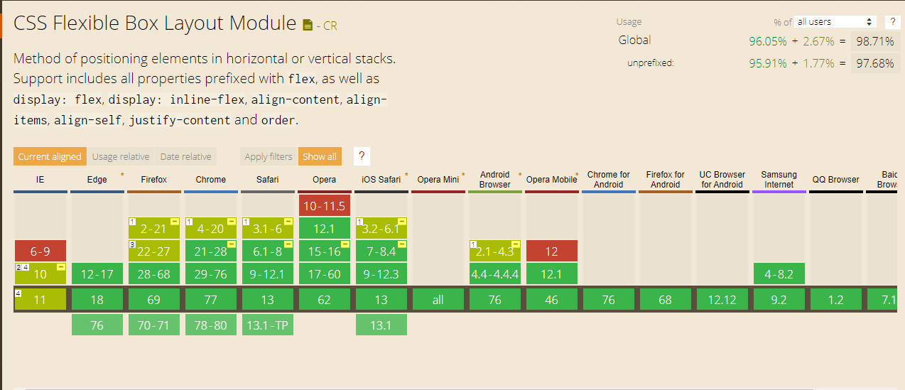
Browser Support
Known bugs and work around: https://github.com/philipwalton/flexbugs

Slide 4

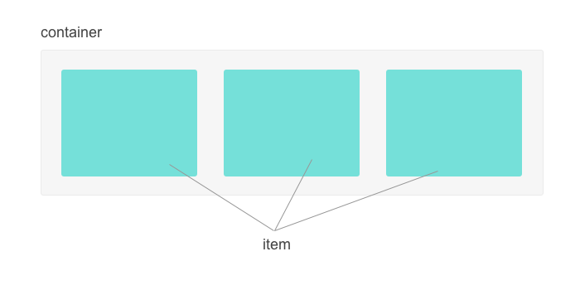
Flex Container
To define a flex container (block or inline):
cross axis
main axis

Slide 5
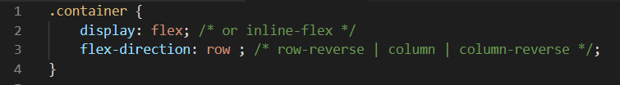
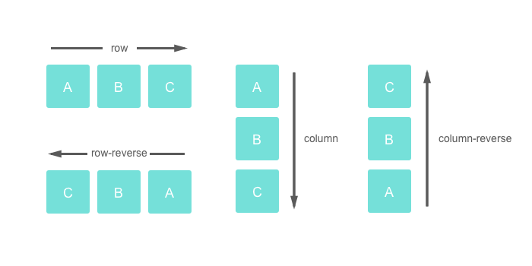
Flex-direction

Slide 6
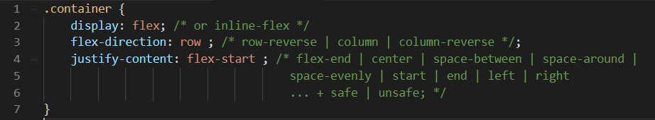
Justify-content
Justify-content defines the alignment along the main axis. It helps distribute extra free space in flex container.
Note: Browser support for these values is nuanced. The safest are flex-start, flex- end and center.

Slide 7
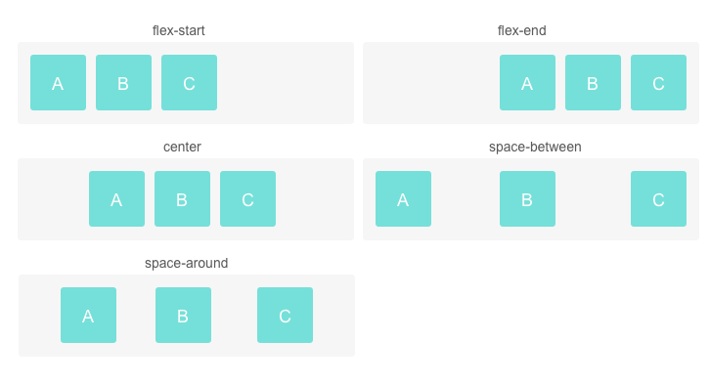
Justify-content

Slide 8
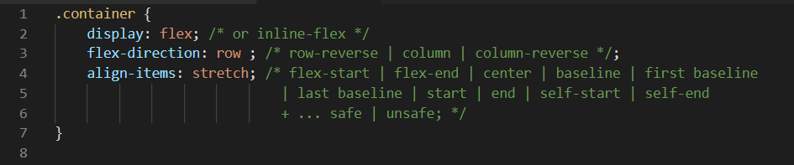
Align-items
This defines the default behavior for how flex items are laid out along the cross axis.
Note: Browser support
Exercise 1: Vertically centering a block of content inside its parent.
Exercise 2: Align media object.

Slide 9
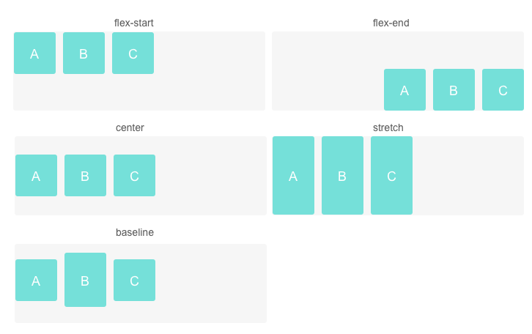
Align-items

Slide 10
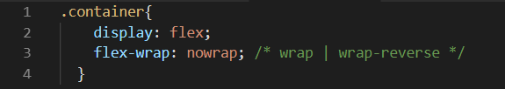
Flex wrap
By default items in a flexbox container are kept on a single line, to force the items to spread across multiple lines, use flex-wrap: wrap.
Flex-flow
A shorthand property called flex-flow allows you to specify flex-direction and flex-wrap in a single line, by adding the flex-direction value first, followed by flex-wrap value, for example: flex-flow: row wrap.
Exercise 3 - Fit 9 blocks, each 300px wide, inside 1000px container.

Slide 11
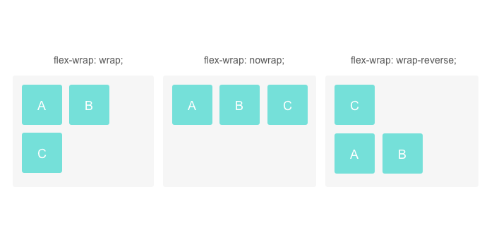
Flex-wrap

Slide 12
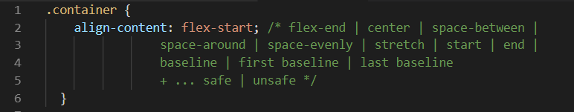
Align content
This property aligns a flex container's lines within when there is extra space in the cross-axis.
This property has no effect when there is only one line of flex items
Note: Browser support.

Slide 13
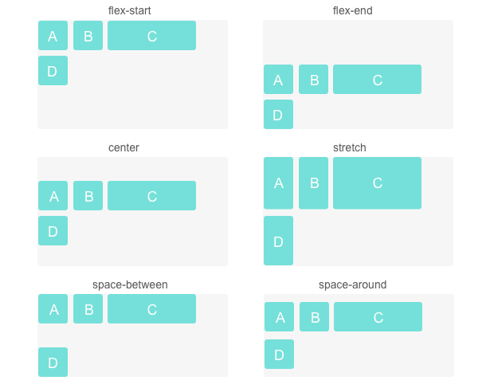
Align content

Slide 14
Container and items properties
Container properties
Properties that apply to each single item
Flex-direction
Justify-content
Align-items
Flex-wrap
Flex-flow
Align-content
Order
Align-self
Flex-grow
Flex-shrink
Flex-basis
Flex

Slide 15

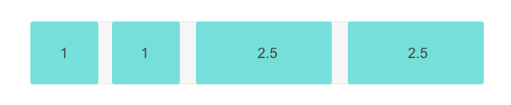
Flex-grow
This defines the ability for a flex item to grow if necessary.
Negative numbers are invalid.
Exercise 4: Sticky footer.
Exercise 5: Forms.

Slide 16

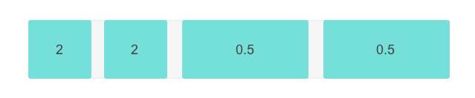
Flex-shrink
This defines the ability for a flex item to shrink if necessary.
Negative numbers are invalid.

Slide 17

Flex-basis
Flex-basis defines the default size of an element before the remaining space is distributed. It can be a length (e.g. 20%, 5rem, etc.) or a keyword (auto, content, filt-content and etc).
Note: in case both flex-basis (other than auto) and width (or height in case of
flex-direction: column) are set for an element, flex-basis has priority.

Slide 18
Understanding of flex
Flex is the shorthand for flex-grow, flex-shrink and flex-basis combined. The second and third parameters (flex-shrink and flex-basis) are optional.
flex: 0 1 auto is default.
flex: 1 0 200px; - this element will be at minimum 200px wide, but it will be allowed to grow if there is extra space. In this case, you can think of the flex-basis as being a minimum width.
flex: 0 1 200px; - this element is 200px at it’s largest, but it’s allowed to be smaller. Here flex-basis is acting like a maximum width.
flex: 1 0 auto; - element has the size of its content. Useful when we don’t want to give the element a min size or max size.

Slide 19

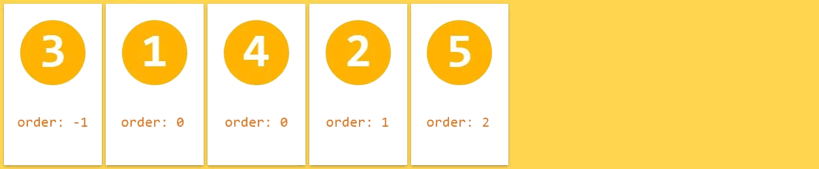
Order
The order property specifies the order of the flex items.
The order value must be a number, default value is 0.
Exercise 4: Mobile-first 3-columns layout

Slide 20
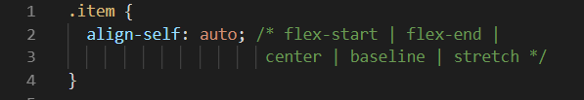
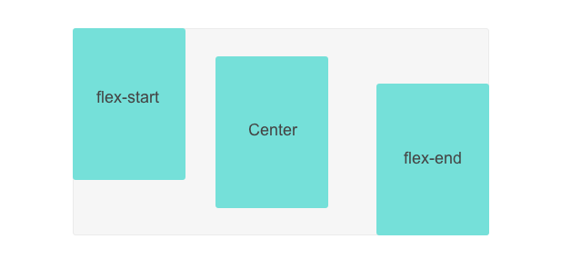
Align-self
This allows the default alignment (or the one specified by align-items property) to be overridden for individual flex items.
Note: float, clear and vertical-align have
no effect on the flex-item

Slide 21
Thank you for
your attention!

